Slide 1

How has the community dealt with MEV?

Slide 2
Systematization of Value Extraction
Assume that extraction is inevitable as validators are rational agents
But some validators have more capability than others
Systematically give every validator access to the most profitable block possible
Proposer Builder Separation (PBS)
Often the profits to validators come at the expense of ordinary users, leaving ordinary users vulnerable to systematic extraction

Slide 3


Systematization of Value Extraction
Ordinary User
Miner / Validator

Slide 4
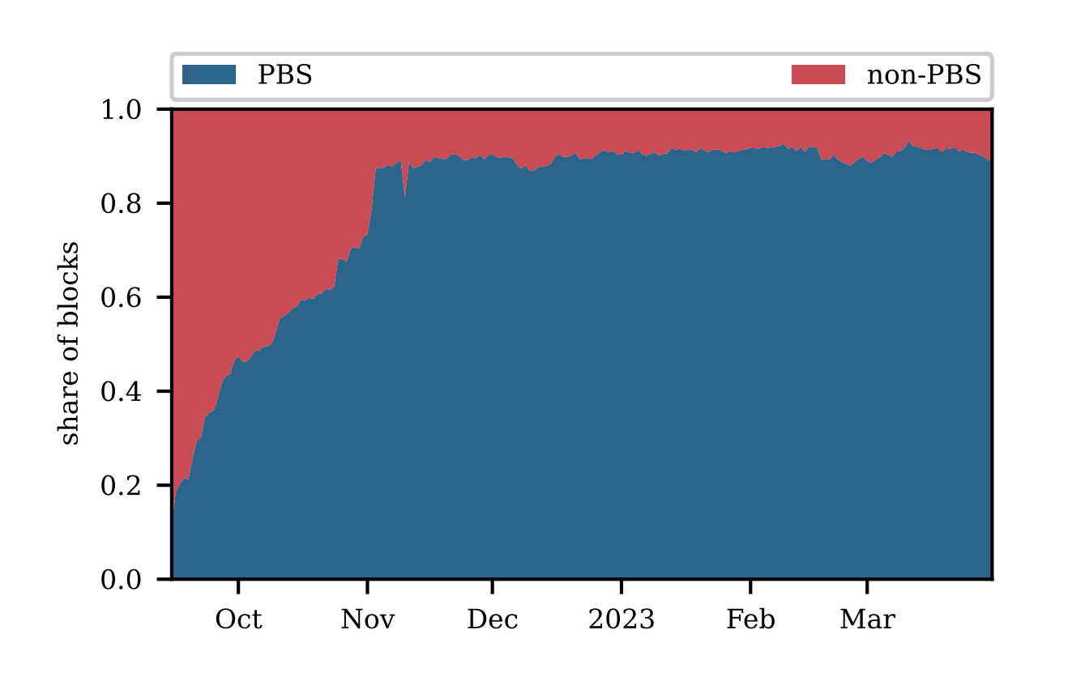
Systematization of Value Extraction
Widespread in industry
Validation of the rational model
[HKTW23] Ethereum's Proposer-Builder Separation: Promises and Realities

Slide 5
Fair Ordering
Temporal Fair Ordering
(Receive Order Fairness) “If sufficiently many (at least 𝛄-fraction) nodes receive a transaction tx1 before another transaction tx2 , then all honest nodes must output tx1 before tx2” [KZGJ20]
Blind Ordering
Ordering policy does not consider transaction contents (except transaction fees). Can be enforced through threshold encryption, Trusted Execution Environments (TEEs)
A large body of academic literature
Protection for users
Why would a rational validator opt in, unless protocol is revamped?

Slide 6
Fair Ordering
Why opt in??
Ordinary User
Miner / Validator
Externality: Latency racing for the top of the block

Slide 7

A practical question
Can users get protection against the most pernicious forms of MEV while accounting for rational validators?

Slide 8

PROF: Protected Order Flow in a Profit-Seeking World

Slide 9
PROF Mechanism
Simple
Backward Compatible
Protects Users without service degradation
Accounts for Rational Validators

Slide 10
PROF Design Summary
Protected OrderFlow / Mempool
Reward R* = R + 𝜀
Reward R
PROF
Original Block B
Enriched Block B*
Fairly Ordered
Transaction Bundle

Slide 11

Validator’s perspective
Which block does the validator choose?
Block B
Reward R
Block B*
Reward R* = R + 𝜀

Slide 12

User’s perspective
Public Mempool
- $MEV
PROF
+ $0.01
Which path does the user choose?

Slide 13
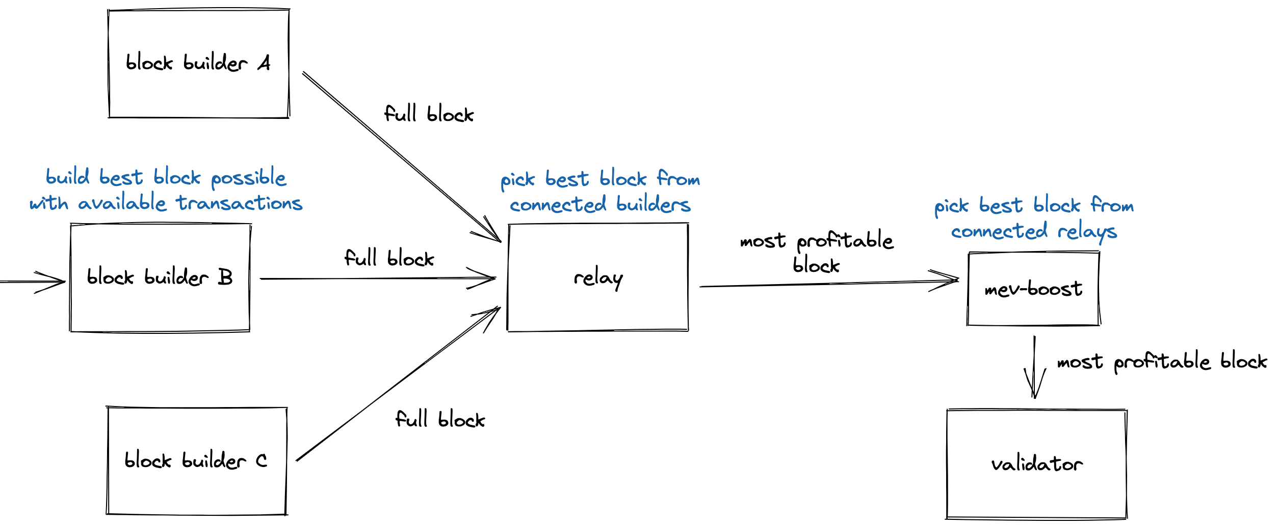
Proposer Builder Separation (PBS)
Trusted Auctioneer

Slide 14

PROF Key Insight
PBS
PBS Blocks
Standard
Relay
Builders
Validator
PROF-enhanced
Relay
Take it or
leave it!
Protected
Order
Flow
PROF
Sequencer
+
PROF
Bundle
Learn practically nothing about PROF transactions if you leave-it

Slide 15
Why should relays adopt PROF?
Relays compete to have their blocks accepted
All else equal, a PROF-enhanced relay is more competitive than a regular relay
Workflow for builders remains unchanged

Slide 16





PBS Workflow
Private Mempool
Private Mempool
Private order flow
Relay
Block bids
Searcher
Builder
Complete blocks
Signed block header
Validator
Transaction bundles
Searcher
Builder
Block payload
Relay
Public transactions
Public Mempool

Slide 17
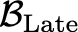
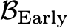

PROF Design Details
Blocks from Builders
Relay
Validator
Max-MEV
Block
Selector
Best Block Header
h
TEE
PROF
Bundle Merger
sig(h)
PROF
Sequencer
Prof Bundle
TLS
Best Full Block

Slide 18
PROF Timeline
PBS
Path
MEV Auction
t = 0
t =
t =
𝛿
Proposer
Commits
(to the Better Path)
PROF
Path
MEV Auction
Start Merging PROF
with the Best Bid
PROF Bundle
Merging
Shorter Auction implies
less profitable block
Extra fee $ from PROF
(length = 12 - 𝛿 secs)
“Latency
Penalty” in PBS

Slide 19
Latency Penalty in PBS Auction
10,000 randomly selected historical auction slots (between 1/3/24 and 4/11/24)
Percentiles of slots for a particular latency and penalty
Example: If auction were ended 85ms earlier, 90% of slots would give ~0.003 ETH less

Slide 20
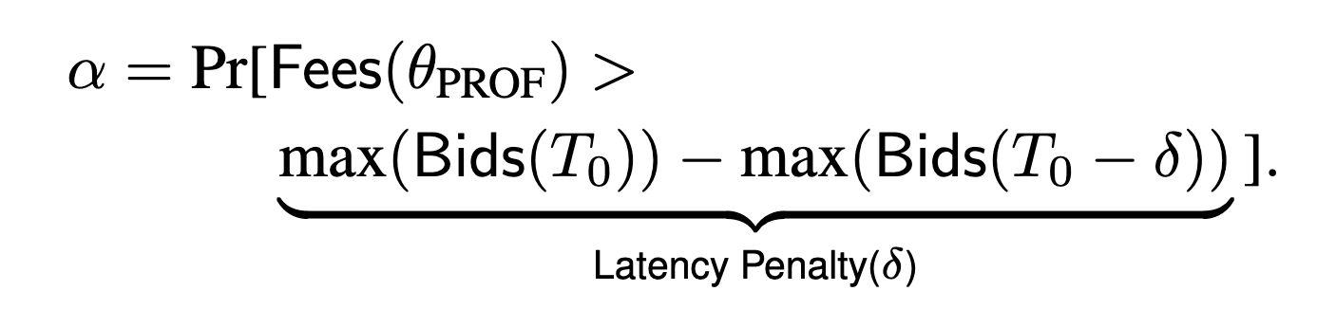
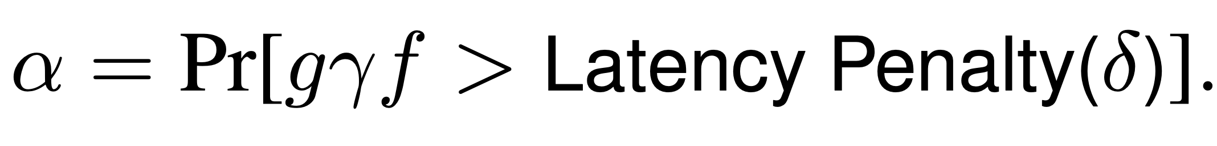
Inclusion Likelihood
Inclusion Likelihood
Relationship between
𝛼, g , 𝛾
Depends on gas used g
Gas used in
PROF bundle
Overhead as a multiple of `”base fee” f

Slide 21
Inclusion Likelihood
Takeaway:
High Inclusion Likelihood of PROF for minimal fee

Slide 22
A Step Further: Redistribution of MEV to Users
DEX A
Exchange B
1. Alice buys 10 ETH
ETH / USD
$100
ETH / USD
$100

Slide 23
A Step Further: Redistribution of MEV to Users
DEX A
Exchange B
1. Alice buys 10 ETH
ETH / USD
$102
ETH / USD
$100
2. Arbitrageur backruns Alice
(buy 10 ETH on B and sell on A)
Profit of $20

Slide 24
A Step Further: Redistribution of MEV to Users
DEX A
Exchange B
1. Alice buys 10 ETH
ETH / USD
$100
ETH / USD
$100
2. Arbitrageur backruns Alice
(buy 10 ETH on B and sell on A)
Profit of $20
Share $X with Alice, $20-X divided up between validator and arbitrageur

Slide 25
PROF-Share : A Step Further
Header h₁ from PROF
Relay
Validator
1
sig(h₁ )
TEE
PROF
Bundle Merger
TLS
2
Redistribute any MEV opportunity created by PROF users back to them
For instance, arbitrage from backrunning of DEX trades
3
7
TLS
6
Header h₂
5
sig(h₂)
θ_{share}
8
B_{PROF}
3
Auction
4
Backrunning
Transactions
Arbitrageurs

Slide 26
Related Redistribution Mechanisms
MEV-Share and MEV-Blocker
Attempts to prevent frontrunning through a trusted intermediary
Yet, needs to leak hints about transaction contents for attracting and facilitating backrunning and redistribution
Widespread in industry : Revenue to the validator from MEV-Share and MEV-Blocker is pivotal in deciding the winner of a majority of auctions!

Slide 27
Other benefits of PROF-Share
PROF-Share transactions are completely private until the validator commits to including them, and then are completely released for backrunning
As a result:
More efficient backrunning compared to backrunning based on hints (gas savings as state is known offchain)
PROF-Share users get to keep almost all of the backrunning profits rather than sharing it with validators (as in MEV-Share)
Organic backrunning between transactions of a PROF bundle – one PROF user could be a “backrunner” of another user if they trade in opposite directions

Slide 28
Economic Utility Analysis
Compare different protection mechanisms
PROF v/s PROF-Share v/s MEV-Share
Model:
DEX : A constant product AMM
An external infinite liquidity market for arbitragers (Centralized Exchanges) – constant price P
Start out with AMM price of P
Each user trades a unit quantity in randomly either direction
Demand Ratio (informally) : A maximum cap on how much volume of trades are in one direction compared to a baseline of net 0 buy and 0 sell

Slide 29
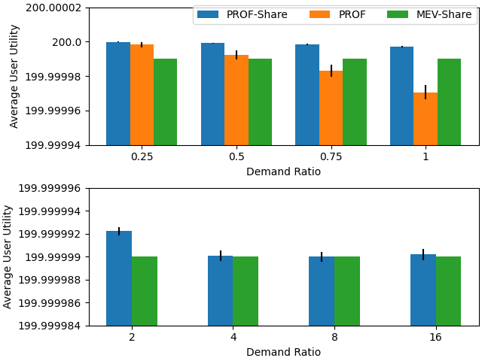
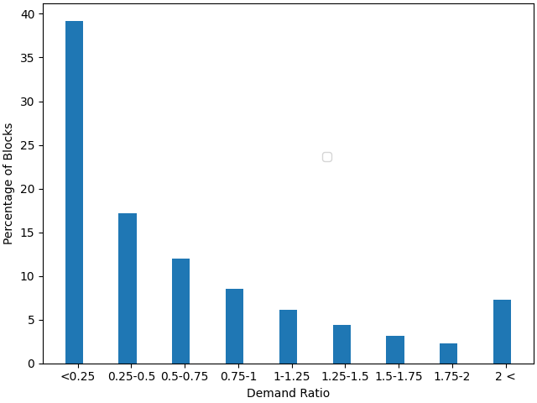
Economic Utility Analysis
Takeaway1 : PROF-Share always delivers the highest value of users
Takeaway2: In times of low net demand, PROF delivers higher value even without redistribution benefits (MEV-Share), thanks to organic backrunning

Slide 30
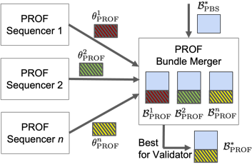
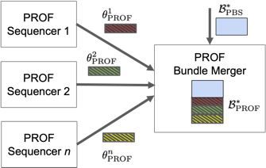
Flexibility in PROF
Multiple Sequencers
PROF Sequencer here is a black-box
Centralized / Decentralized
PROF supports any ordering policy

Slide 31
Conclusion
PROF: A simple backward-compatible system designed for protecting users from harmful MEV extraction, while accounting for the profit-maximizing nature of validators
PROF Endgame Thesis: Transactions that want top of the priority can go through the gauntlet of MEV auctions*. All other transactions should go through PROF to enjoy protection from MEV
*nullifies the externality of latency racing in fair and blind ordering

Slide 32


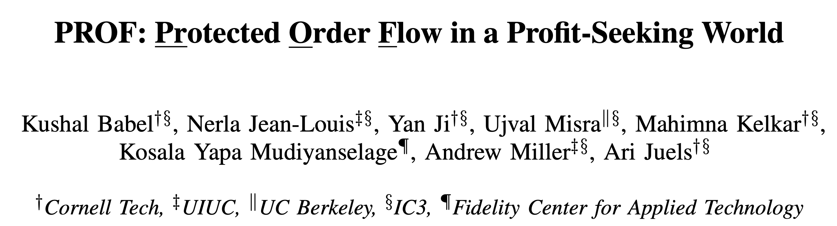
To Learn More
Visit the website: prof-project.github.io (FAQs)
Watch the demo of PROF-enriched blocks landing at validators
Uniswap RFP: $50k for maturing PROF implementation
Announcements @PROF_MEV
Contact: babel@cs.cornell.edu
PROF paper just released!
https://arxiv.org/abs/2408.02303

Slide 33
Appendix

Slide 35
Execution Perf

Slide 36
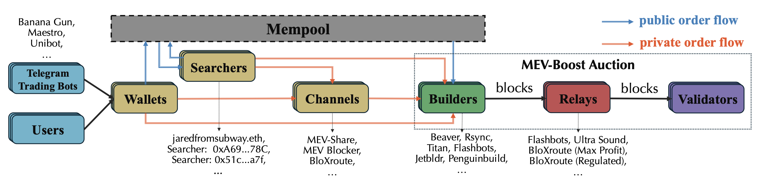
An Entire Supply Chain (PBS)
[YNZ24] Decentralization of Ethereum’s Builder Market

